Slide 17
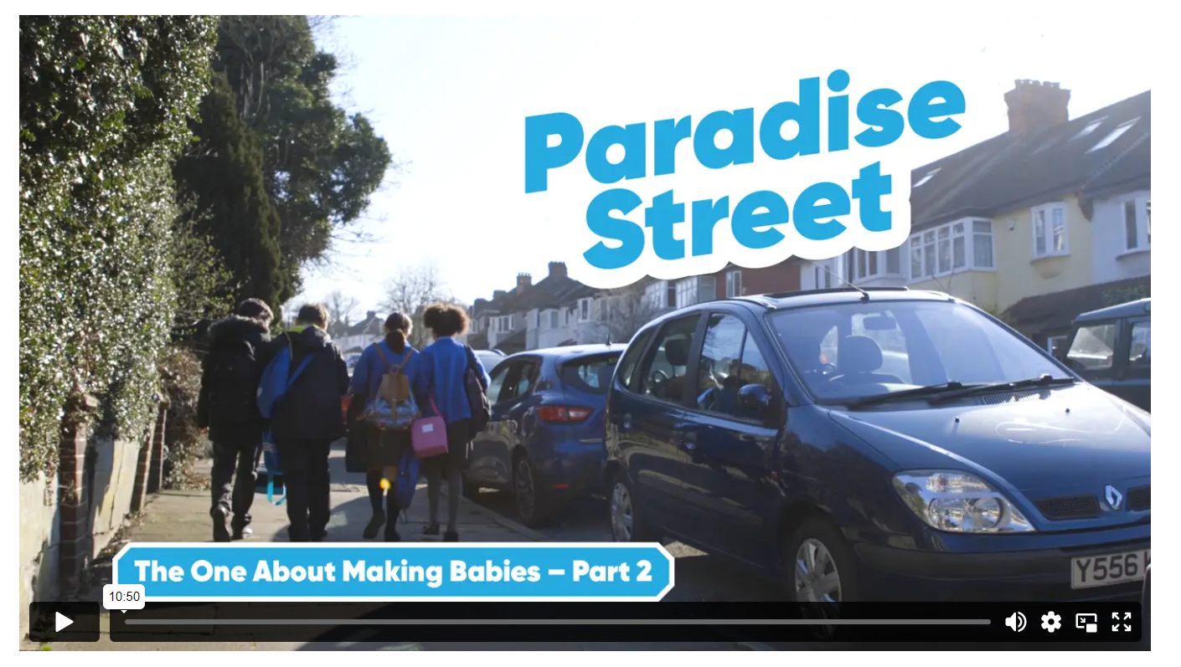
Now we have the opportunity to view the episode from Paradise Street which covers sexual intimacy from a Catholic viewpoint.

